Slide 1
Stroke Prediction
Team
SREERAJ
DHARISH
SHREYASH

Slide 2
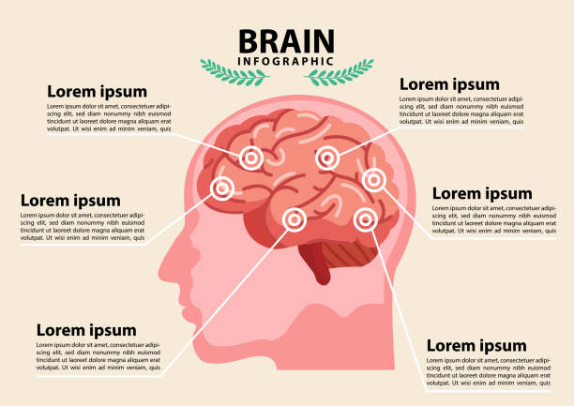
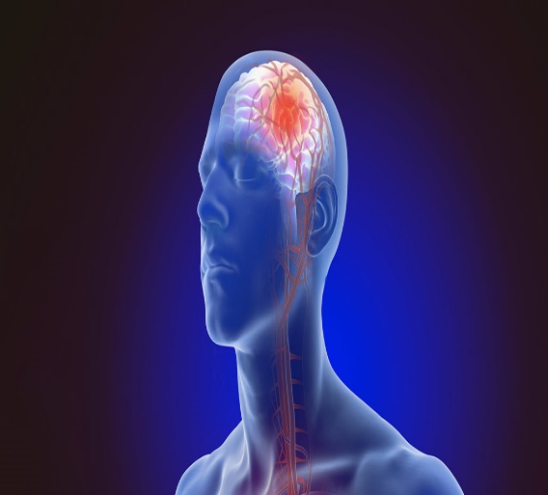
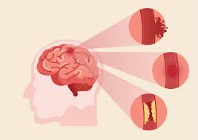
Stroke Prediction
According to the World Health Organization (WHO) stroke is the 2nd leading cause of death globally, responsible for approximately 11% of total deaths.
The main objective of this project is to develop a machine learning model which detects occurrence of stroke in human beings.
The prediction whether a patient is likely to get stroke based on the input parameters like gender, age, various diseases, and smoking status.

Slide 3
What is stroke ?
How stroke can be prevented?
In medicine, a loss of blood flow to part of the brain, which damages brain tissue.
Strokes are caused by blood clots and broken blood vessels in the brain.
Symptoms include dizziness, numbness, weakness on one side of the body, and problems with talking, writing, or understanding. language.
Some irreversible factors, such as age and family history, are likely to increase the risk of stroke. These factors cannot be modified. However, many such preventable or modifiable factors can help prevent strokes.

Slide 4
03
Requirements analysis
Exploratory data analysis
Contents of Project
02
01
Machine learning Model to predict stroke.

Slide 5
TECHNIQUES USED BY PROJECT
The practice of examining large pre-existing databases in order to generate new information.
1
Data Mining
Machine Learning
2
Machine learning is an application of artificial intelligence (AI) that provides systems the ability to automatically learn and improve from experience without being explicitly programmed.

Slide 6





Flow control of
Project
Requirement Analysis
Data is collected from various sources.
Enhancing performance
The performance of model is improved by again refining the data and building the model again.
Exploratory Data Analysis
The dataset is being investigated to discover hidden patterns and anomalies.
Performance
Testing
After creating the model the performance of model is being tested by using unknown data.
The performance is analyzed using accuracy score and ROC curve.
Classifier
The datasets are trained.
Model is created.

Slide 7
Features
gender
age
hypertension
heart_disease
ever_married
work_type
Residence_type
avg_glucose_level
bmi
Stock Prediction
Dataset
TOTAL
5110
DATASETS
USED
YES
4861
YES
No
95.13%
NO
249
4.87%

Slide 8



FEATURE DETAILS
Here we have 12 features. In which we have 3 continues values and 9 categorical variables
Categorical
gender
hypertension
heart_disease
ever_married
work_type
Residence_type
smoking_status`
COLUMNS
CATEGORICAL
Target
TARGET
NUMERIC
Numeric
YES :- To represent those have stroke.
No :- To represent those don’t have stroke.
age
avg_glucose_level
bmi

Slide 9
STEPS FOLLOWED IN EDA
2
4
3
5
1
Checking the null values and treating the null values.
Checking the correlation and multicollinearity among features.
Understanding data using different visualization techniques.
Detecting outliers and
removing it along with unwanted features .
Checking the summary statistics.

Slide 10
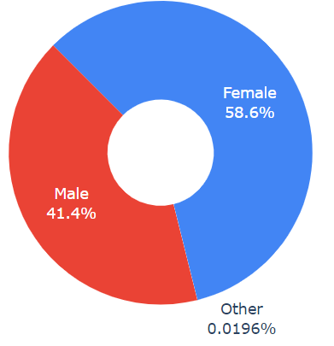
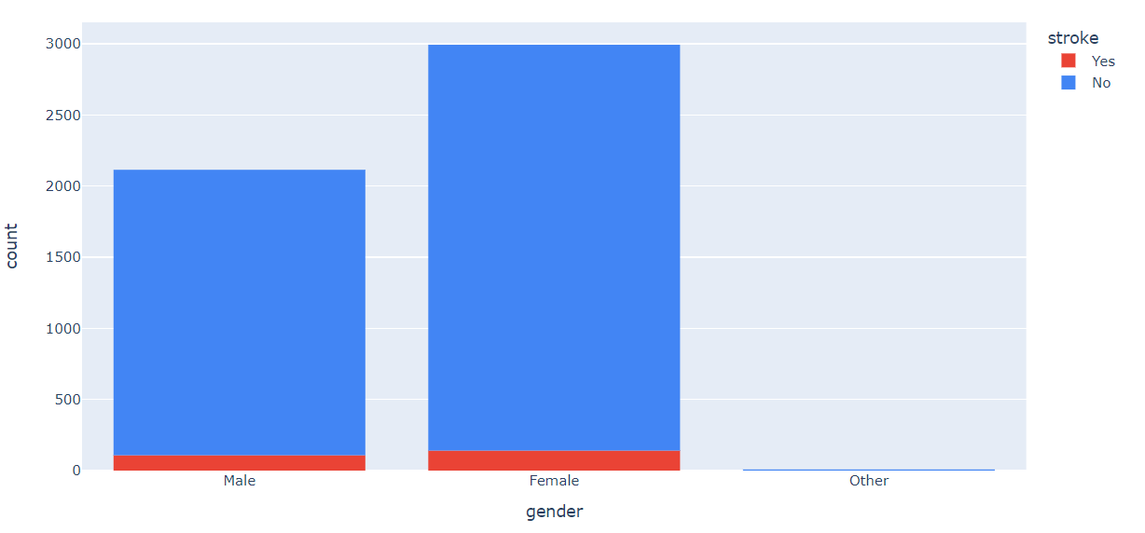
DATA VISUALIZATION ON GENDER WISE
FEMALE
MALE
We can say that more information has been collected from female. The records of females are dominating more.
141 Females had a stroke.
It cannot be concluded that Females get more strokes than Males because the number of Females tested in this dataset is much higher than the number of Males tested.
We can find that 41.4 % of data are being collected of male.
108 males had a stroke.
VS
Other
The gender other can be ignored since it has only a few records.

Slide 11
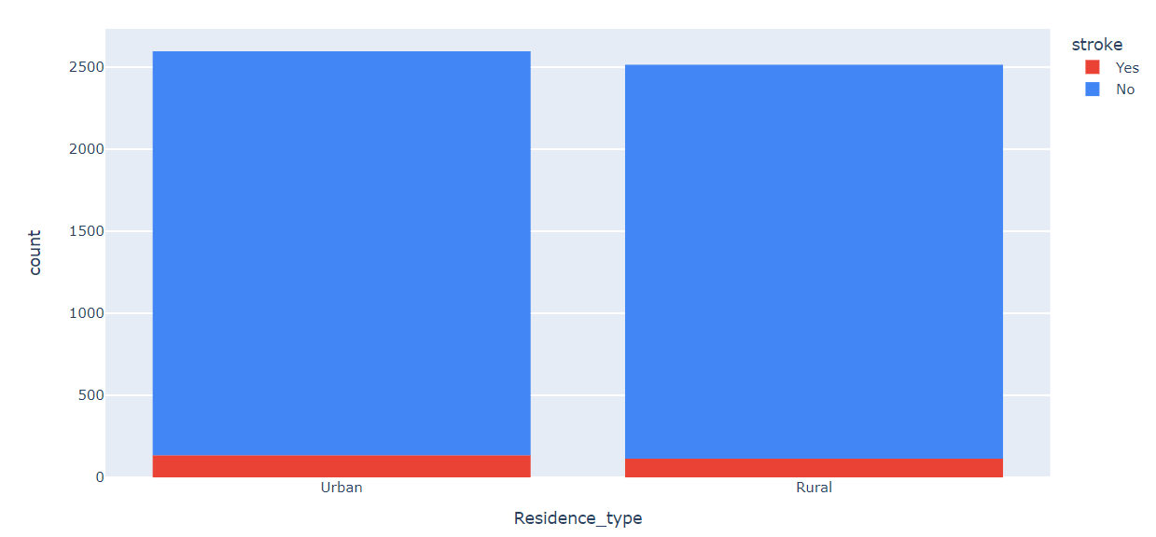
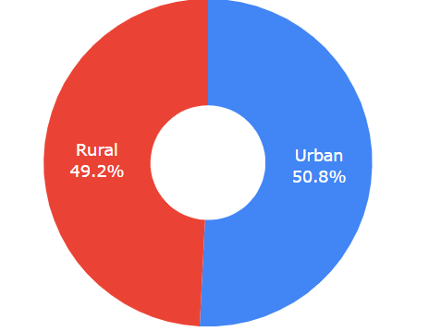
COMPARISON ON RESIDENCE TYPE
The dataset contains balanced amount of records on people living in urban and rural area.
The likelihood of having a stroke is same for living in an urban region and in a rural region.

Slide 12
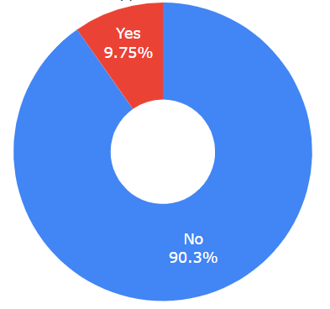
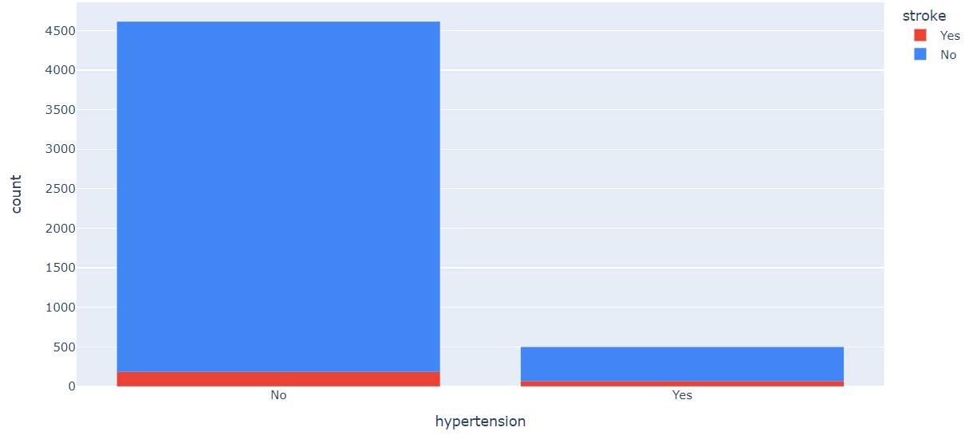
COMPARISON ON HYPERTENSION
The number of people who has hypertension is much lower than the number of people who do not.
The proportion of people who had a stroke in the No hypertension category is much higher than the proportion of people who had a stroke in the hypertension category.
But the number of people who had hypertension is significantly lower than the number of people who didn't, so it cannot be confidently concluded that people with hypertension is more likely to suffer from a stroke than people with no hypertension.

Slide 13
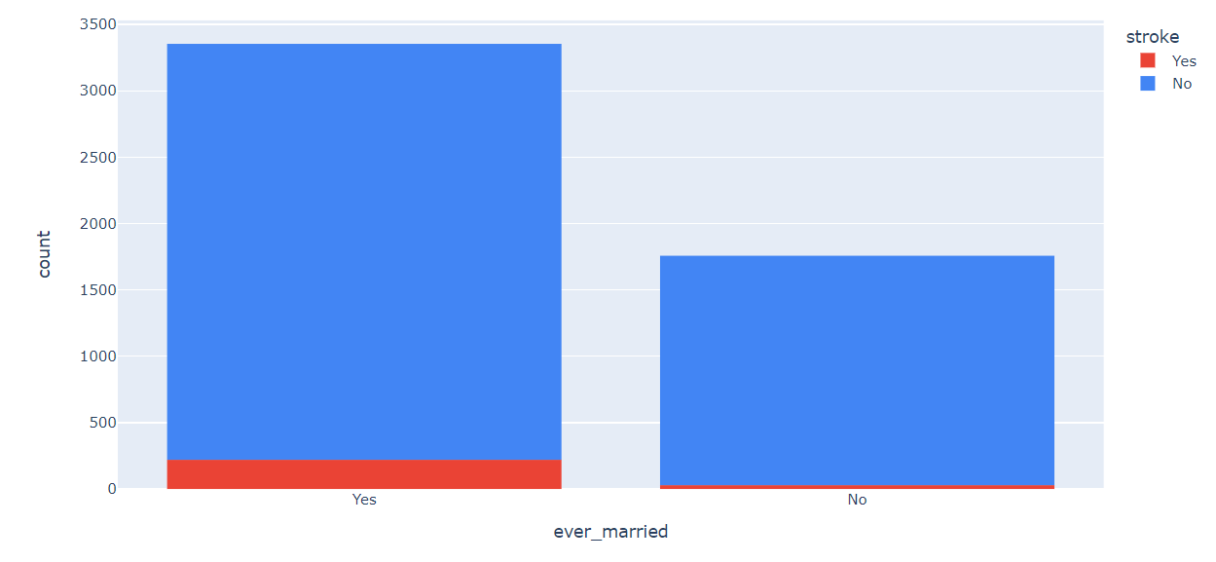
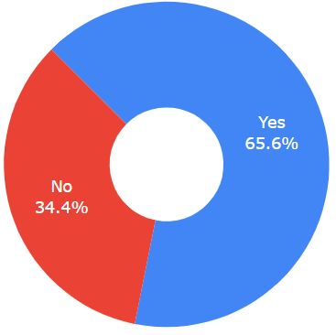
COMPARISON ON EVER MARRIED
Most people who had a stroke are married.
The percentage of people who are married is more.

Slide 14
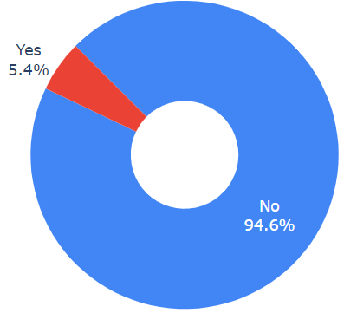
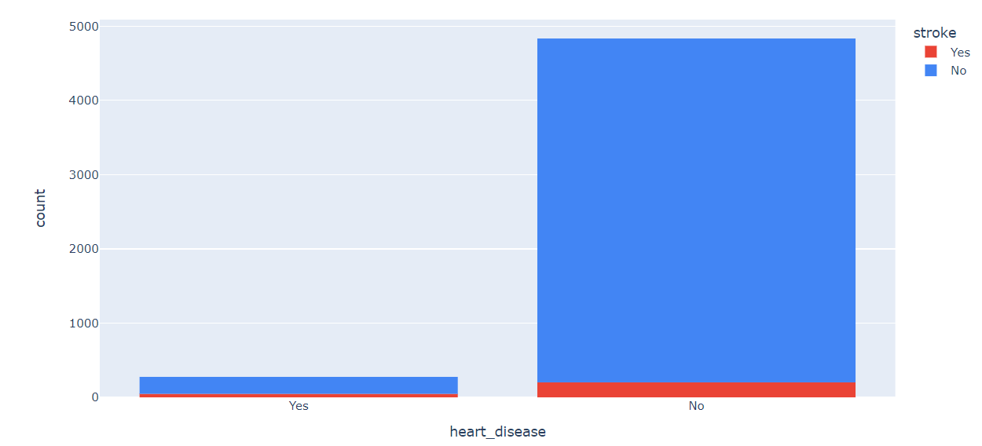
COMPARISON ON HEART DISEASE
The number of people who had heart disease is much lower than the number of people who did not.
The proportion of people who had a stroke in the No heart disease category is much higher than the proportion of people who had a stroke in the heart disease category.
But the number of people who had heart disease is significantly lower than the number of people who didn't, so it cannot be confidently concluded that people with heart disease is more likely to suffer from a stroke than people with no heart disease.

Slide 15
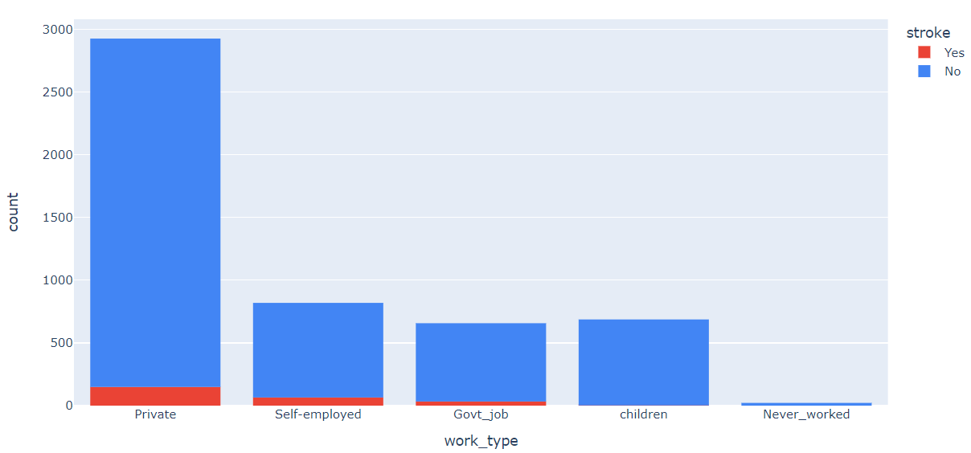
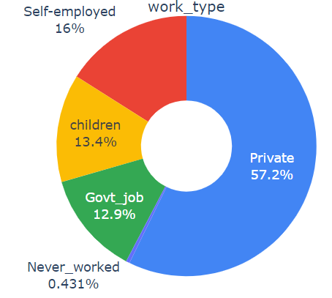
COMPARISON ON WORK TYPE
The dataset contains records of people working in private sector more compared to others.
Most people who had stroke work in private sector.

Slide 16
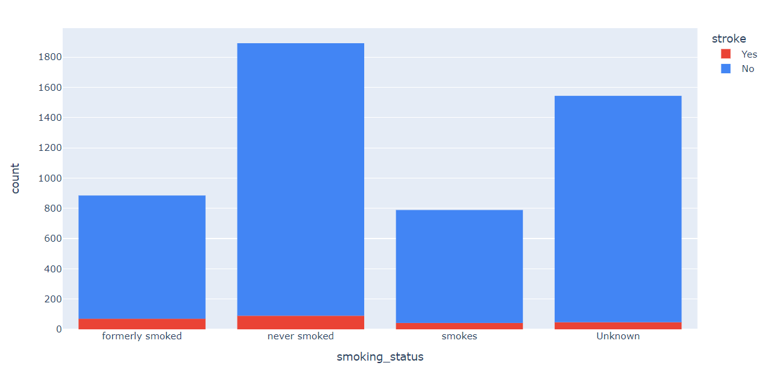
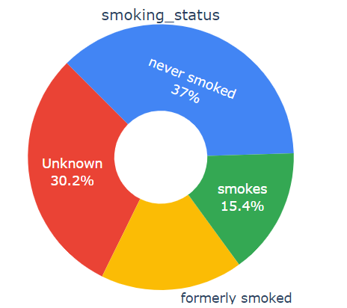
COMPARISON ON SMOKING TYPE
The likelihood of having a stroke is more for people who never smoked.

Slide 17
COMPARISON ON NUMERIC DATA
Stroke Rate
High BMI
65%
Body Mass Index
Low BMI
35%
Average Glucose Rate
High glucose level
80%
Low glucose level
20%
People who had a stroke have a slightly higher BMI than those who never had a stroke.
Most people having a stroke usually have a higher Average glucose level than those who never had a stroke

Slide 18
COMPARISON ON AGE GROUP
60%
25%
10%
5%
0-20
20-40
40-60
60-80
Most people having a stroke are old people

Slide 19
Different type of models used
XGB
XGBoost, which stands for Extreme Gradient Boosting, is a scalable, distributed gradient-boosted decision tree (GBDT) machine learning library.
Logistic Regression
Logistic regression is a process of modeling the probability of a discrete outcome given an input variable.
The most common logistic regression models a binary outcome; something that can take two values such as true/false, yes/no, and so on.
6.
XGB
1. Logistic Regression
Kneighbors Classifier
KNN works by finding the distances between a query and all the examples in the data, selecting the specified number examples (K) closest to the query, then votes for the most frequent label (in the case of classification) or averages the labels (in the case of regression).
Naïve Bayes
Naive Bayes classifiers are a collection of classification algorithms based on Bayes' Theorem.
5.
Naive Bayes
2.
Kneighbors
Classifier
4. Random
Forest
3.
SVC
Support Vector Machine
Support Vector Machine is a linear model for classification and regression problems.
It can solve linear and non-linear problems and work well for many practical problems.
The idea of SVM is simple: The algorithm creates a line or a hyperplane which separates the data into classes.
Random Forest
Random Forest is a classifier that contains a number of decision trees on various subsets of the given dataset and takes the average to improve the predictive accuracy of that dataset.

Slide 20
COMPARISON OF MODEL
Accuracy
Random Forest
01
93.8%
XGB Classifier
02
93.4%
Decission Tree Classifier
03
88.9%

Slide 21

FUTURE ENHANCEMENT
Develop a mobile app
Develop an application for various institutions.
Research
We can integrate our model with IOT and android app which keeps on tracking our health condition and give alert if our health conditions are going to lead stroke.
With the data of various institution we can develop a health tracking system of there customers by which institutes can use for target marketing.
We can perform more deep research on this topic and develop
more accurate model using advanced algorithms.

Slide 22
Advantages & Disadvantages
Advantages
The global death rate can be reduced.
Early detection of stroke can be useful for providing medical support early.
Will be helpful for improving the lifestyle of people more healthy.
Disadvantages
Learning and implementing the complex algorithms required to build model is time consuming.
Deployment and managing infrastructure to analyse large dataset required to build accurate models and generate prediction in high scale is expensive.

Slide 23
Thank you

